Slide 1
LLM4TS
Ching Chang

Slide 2
3 Aspects
Motivation: Applying pretrained language model in few-shot learning for time-series data.
Pretrained LMs
PEFT (Parameter-Efficient Fine-Tuning) techniques
Time-Series Tasks
NLP
CV
Adapter
GPT-2
BERT
Forecasting
Long-term Forecasting
Short-term Forecasting
Classification
Anomaly Detection
Imputation
ViT
LoRA
Prefix Tuning
…
LLaMA
T5
BEiT
…
LLaMA wins PaLM, GPT-3, T5, …

Slide 3
Questions
Q1: What are the types of pretrained LMs that we can use for multi-modal tasks? LLaMA, GPT2
Q2: How can we adapt pretrained LMs for time-series data? RevIN + Patching
Q3: What are the three main time-series tasks? Forecasting, Classification, Anomaly Detection
SOTA methods? Problem Definition? Datasets? Metric? Experiments?
Q4: How do we finetune pretrained LMs? Adapter, LoRa, Prefix Tuning

Slide 4
Surveyed Papers – Outline
GPT2, LLaMA
The foundation models
(FPT) Pretrained Transformers As Universal Computation Engines
The starting point paper to discuss the usage of pretrained LM for non-language tasks
(FPT-TS) One Fits All: Power General Time Series Analysis by Pretrained LM
Understand how to apply Pretrained LM on time-series
Transformers in Time Series: A Survey
Understand how to apply Transformer on three different time-series tasks
IJCNLP-AACL 2022 + EMNLP 2022 Tutorials + UniPELT + LLaMA-Adapter V1 V2
Understand how to use different PEFT techniques
LLaMA-TSAdapter
Combine everything we’ve learned into time-series domain
DLinear + Crossformer + PatchTST
SOTA time-series forecasting
…
SOTA time-series classification
…
SOTA time-series anomaly detection

Slide 5
GPT2, LLaMA
The foundation models

Slide 6
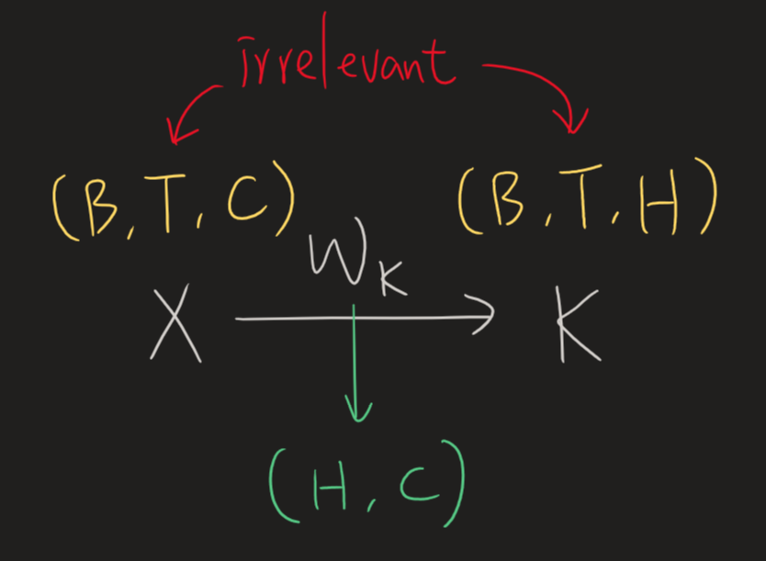
Causal LM – Training vs. Inference
The context window size (also known as block_size, n_positions, or max_seq_len) won't affect the model size except for the positional embedding part.
1, 2, 3, 4, 5, 6, 7, 8
1, 2, 3, 4, 5, 6, 7, 8
0, 1, 2, 3, 4, 5, 6, 7
0, 1, 2, 3, 4, 5, 6, 7
1
0
We'd like the transformer to be accustomed to seeing contexts ranging from as little as one token up to the block size.
Transformers are capable of accepting input lengths ranging from 1 to the block size.
True for both training and inference

Slide 7
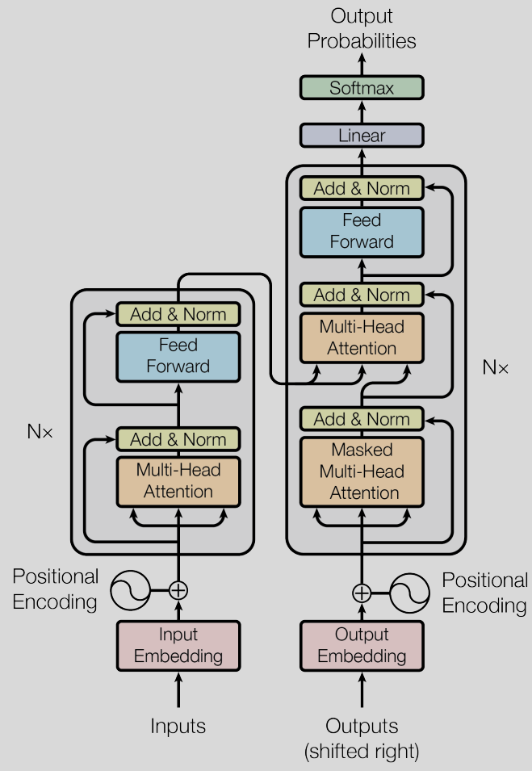
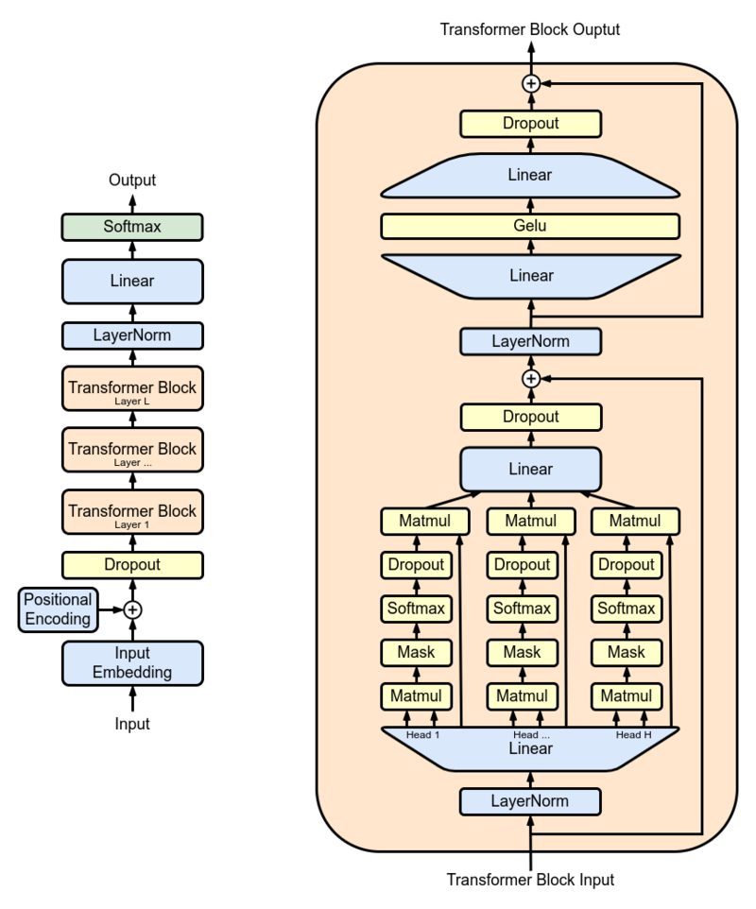
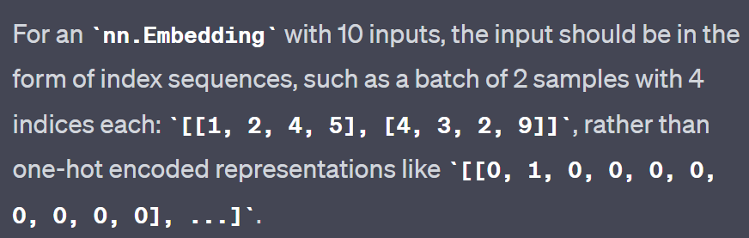
GPT2
Output layer
Hugging Face’s gpt2
(can bypass input embedding by using `inputs_embeds` instead of `input_ids`)
Trainable instead of fixed sinusoidal functions
bypassable
Input layer
Input
`nn.Embedding` is a trainable lookup table, resembling a bias-free linear layer with one-hot inputs.

Slide 8



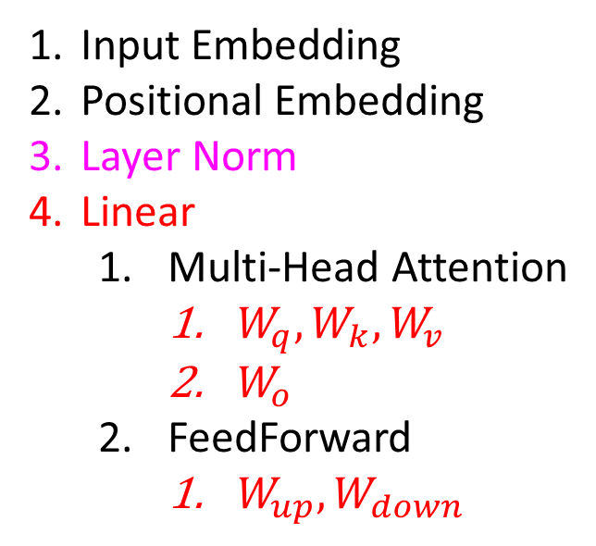

GPT2 – All trainable components
$$W_{down}$$
Output layer
$$W_{up}$$
Hugging Face’s gpt2
(can bypass input embedding by using `inputs_embeds` instead of `input_ids`)
Input Embedding
Positional Embedding
Layer Norm
Linear
Multi-Head Attention
$W_{q},W_{k},W_{v}$
$W_{o}$
FeedForward
$W_{up},W_{down}$
$$W_{o}$$
Trainable instead of fixed sinusoidal functions
bypassable
Input layer
$$W_{q},W_{k},W_{v}$$
`nn.Embedding` is a trainable lookup table, resembling a bias-free linear layer with one-hot inputs.

Slide 9
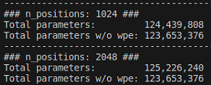
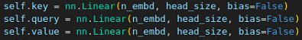
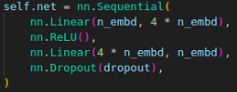
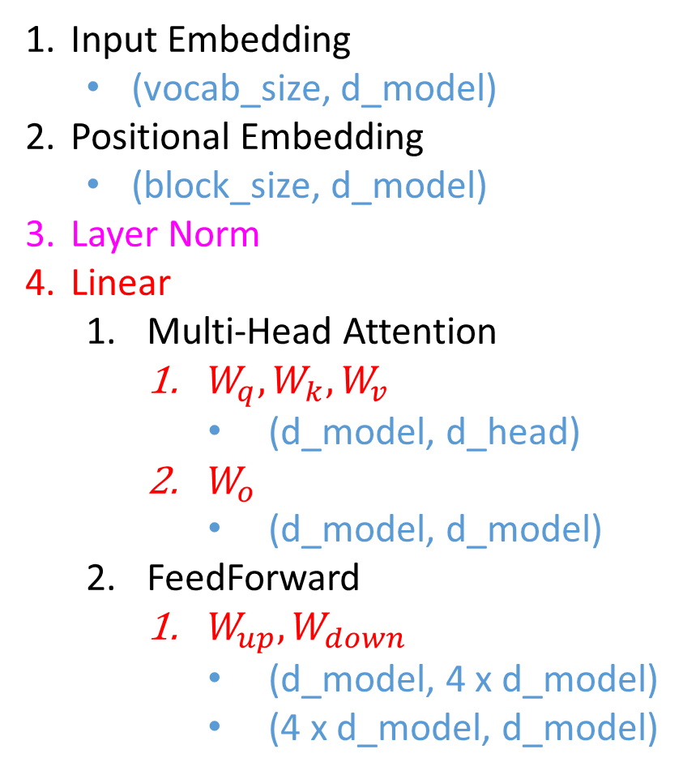
GPT2 – All trainable components
The context window size (also known as block_size, n_positions, or max_seq_len) won't affect the model size except for the positional embedding part.
n_embd = d_model
head_size = d_head
Input Embedding
(vocab_size, d_model)
Positional Embedding
(block_size, d_model)
Layer Norm
Linear
Multi-Head Attention
$W_{q},W_{k},W_{v}$
(d_model, d_head)
$W_{o}$
(d_model, d_model)
FeedForward
$W_{up},W_{down}$
(d_model, 4 x d_model)
(4 x d_model, d_model)

Slide 10
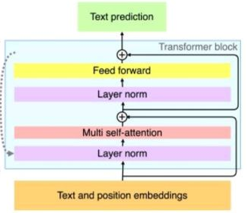
GPT2 – 4 Important hyperparameters
4 important hp for the model:
n_positions
n_embd
n_layer
n_head
n_layer
n_embd
n_head
n_positions

Slide 11
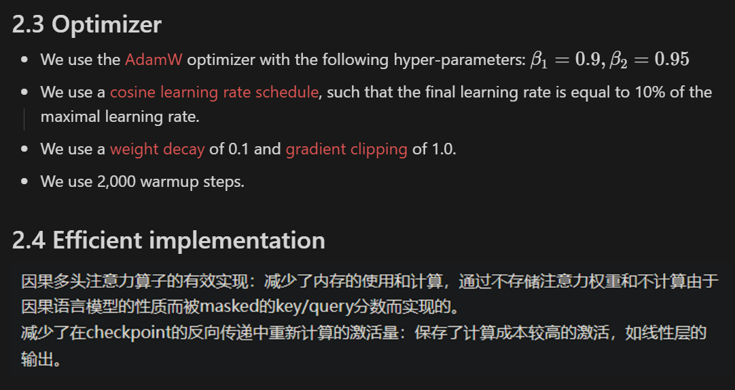
LLaMA – 3 Changes
SwiGLU
Pre-normalization [GPT3]
SwiGLU activation function [PaLM]
Rotary Embeddings [GPTNeo]
RMSNorm
RMSNorm
Rotary Embedding
RMSNorm

Slide 12
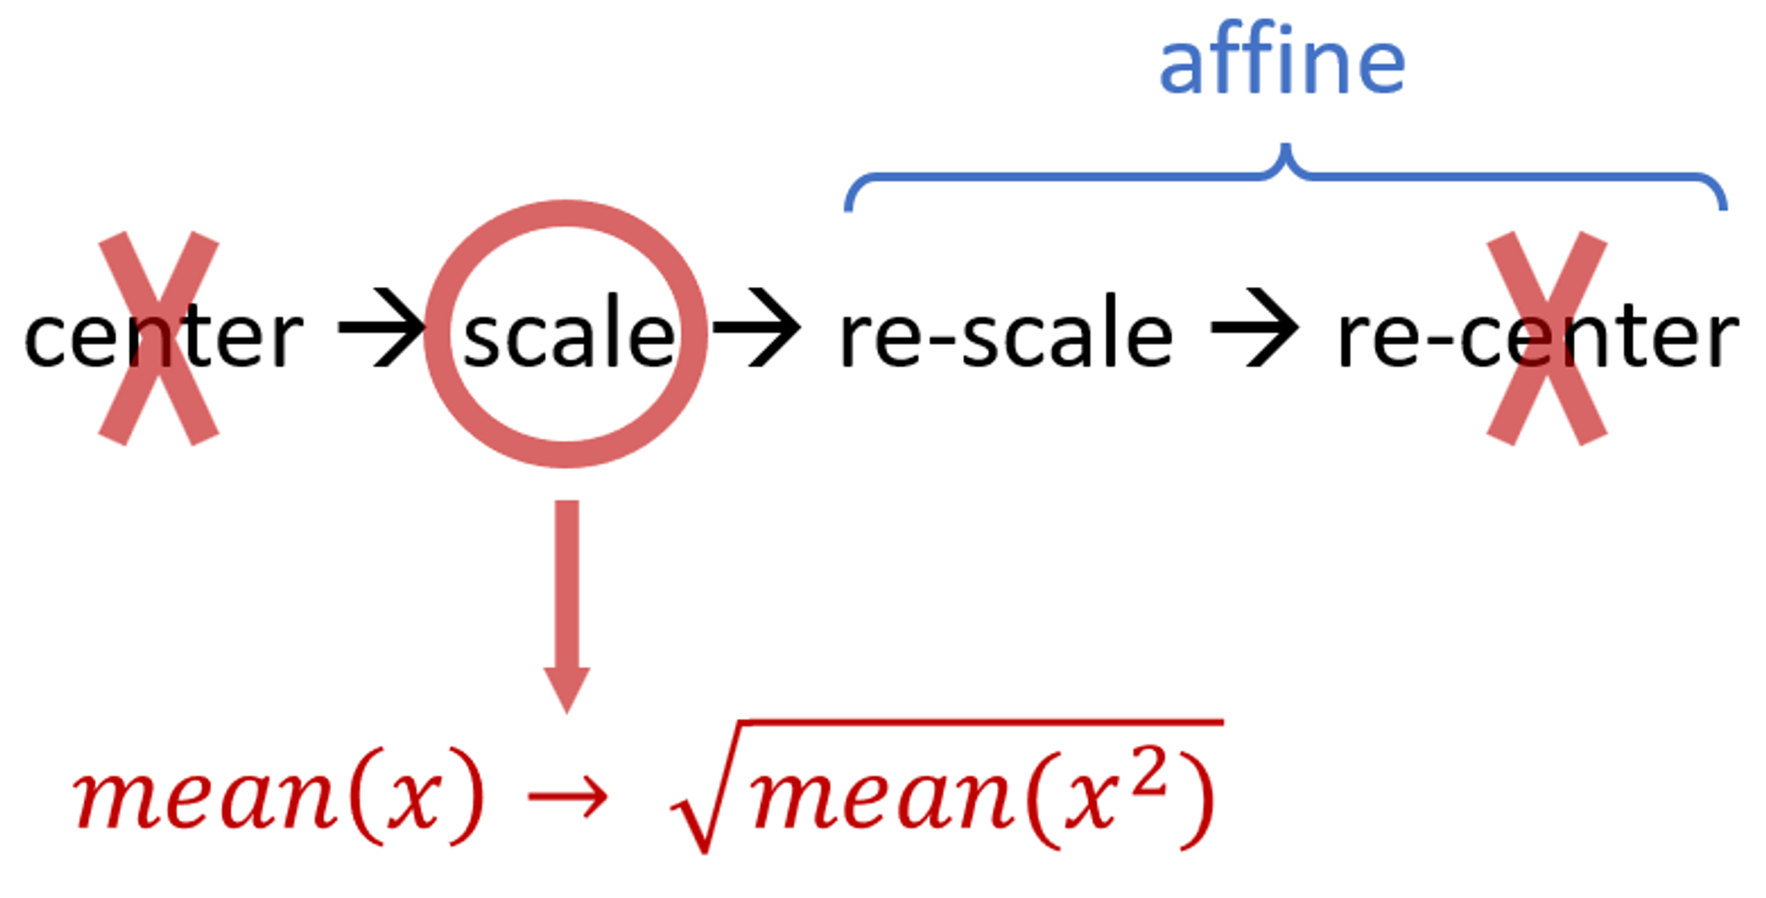
LLaMA – 1. Pre-normalization [GPT3]
We normalize the input of each transformer sub-layer, instead of normalizing the output.
Already in GPT2
We use the RMSNorm normalizing function.
RMSNorm is a simplified LayerNorm.
RMSNorm
RMSNorm
RMSNorm

Slide 13
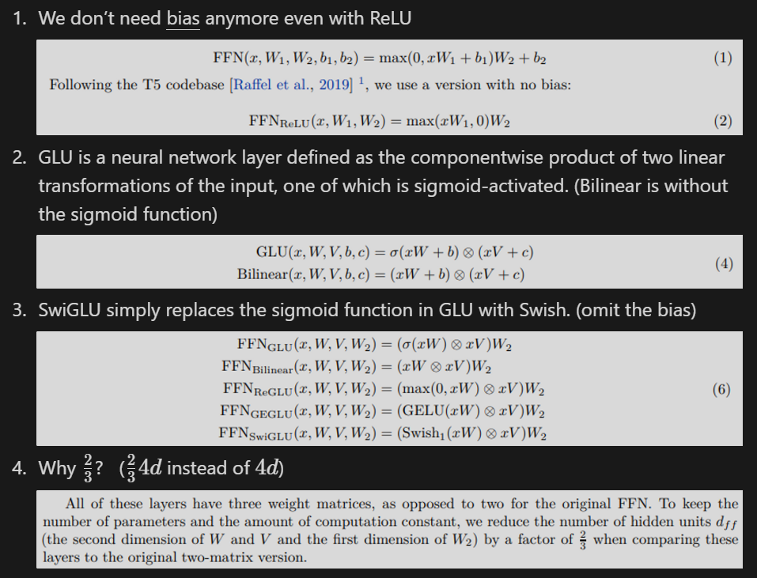
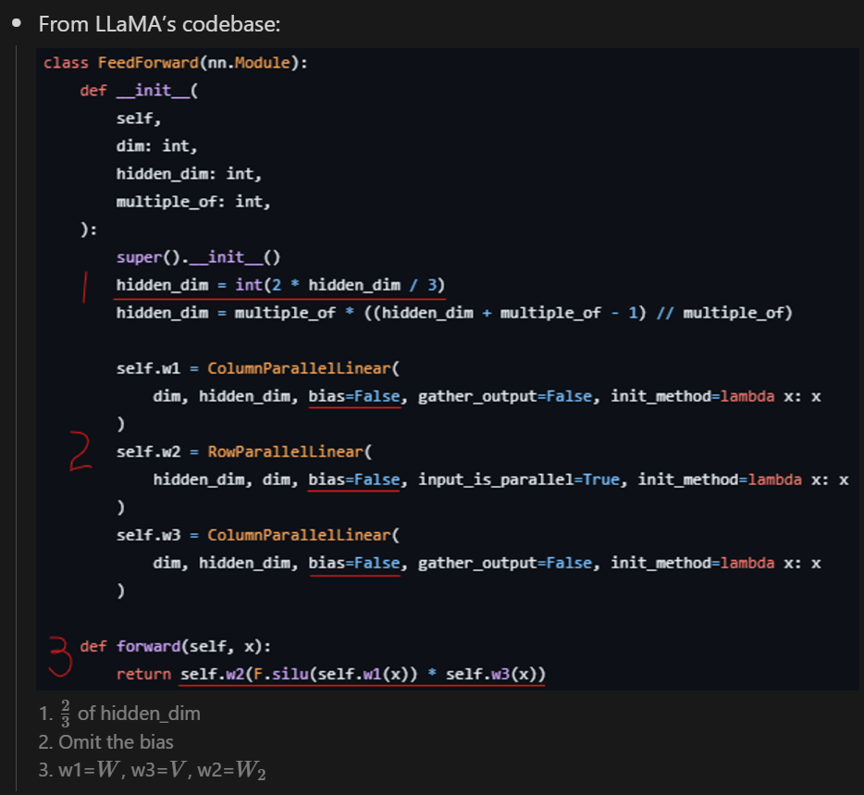
LLaMA – 2. SwiGLU activation function [PaLM]
SwiGLU

Slide 14
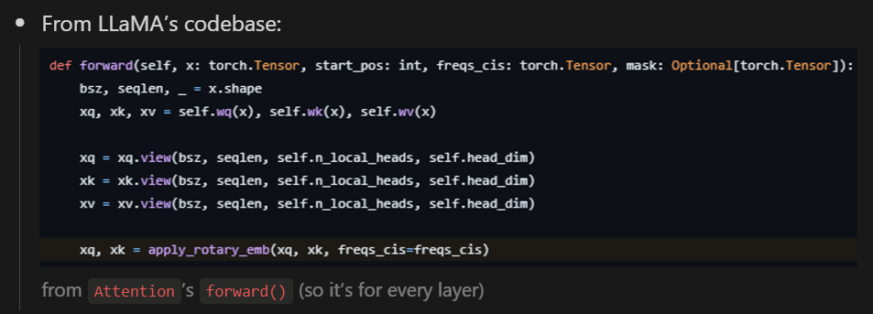
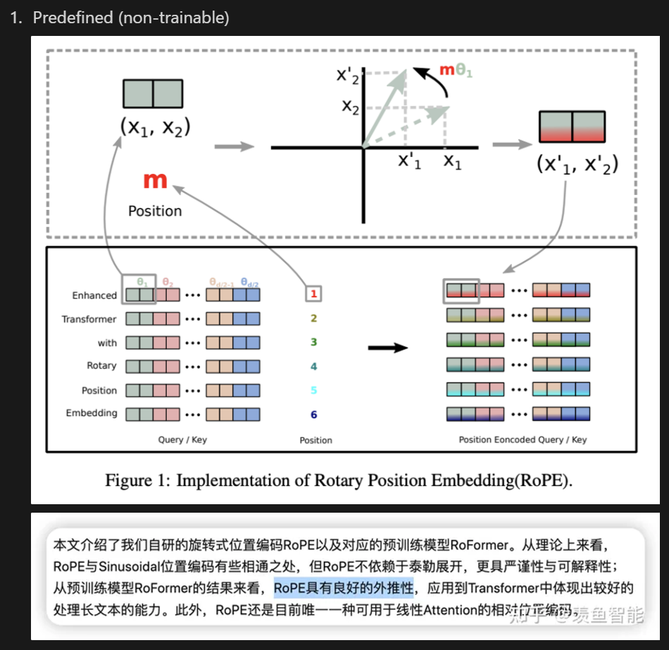
LLaMA – 3. Rotary Embeddings [GPTNeo]
Rotary Embedding

Slide 15
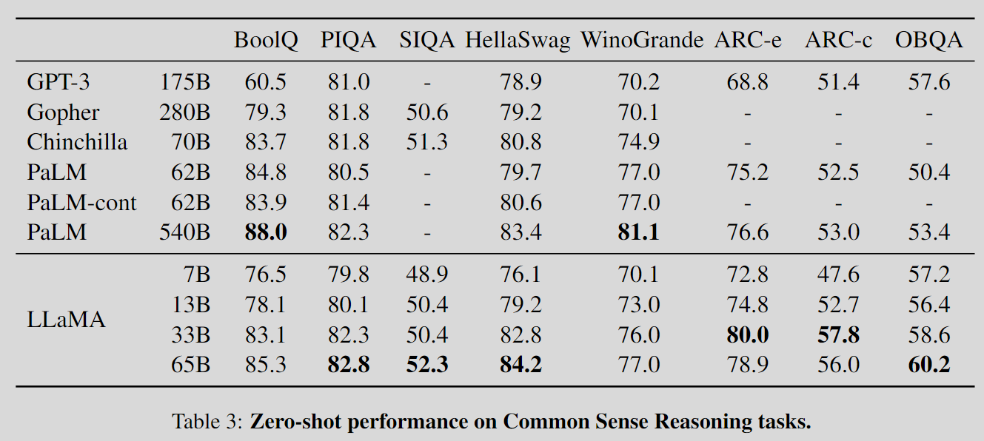
LLaMA – Results

Slide 16
(FPT) Pretrained Transformers As Universal Computation Engines
The starting point paper to discuss the usage of pretrained LM for non-language tasks

Slide 17
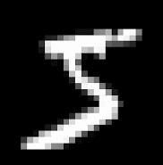
Evaluating Classification Tasks Across Different Modalities
I only list the most representative task.
MNIST/CIFAR-10
Original: 32x32 → 10
Now: 4x4 pixel = 1 image patch, so now we have 8x8 = 64 image patches
Input for GPT-2: 64 tokens of dimension 16

Slide 18
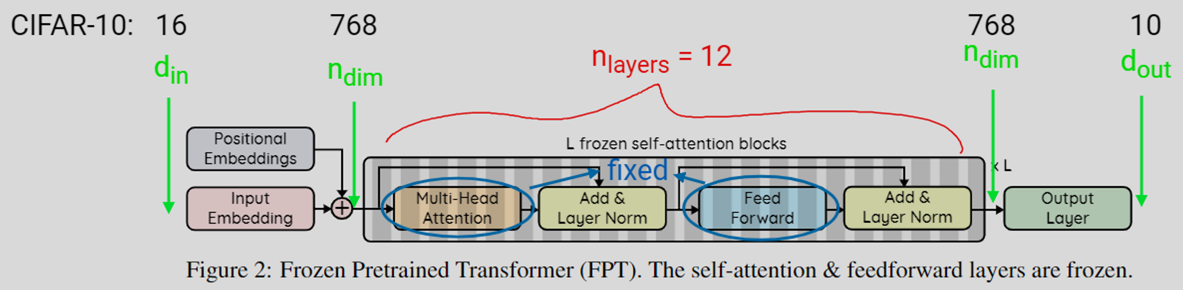
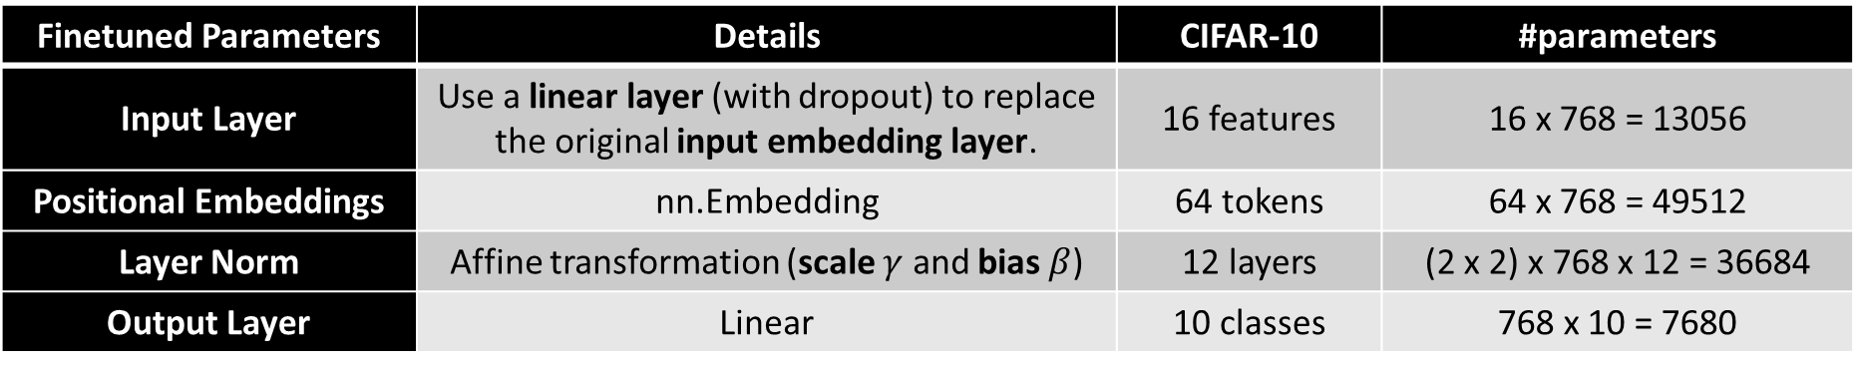
Frozen Pretrained Transformer (FPT)
For the base CIFAR-10 model with 124M parameters, these come out to approximately 0.086% of the network.
Finetuned Parameters | Details | CIFAR-10 | #parameters
Input Layer | Use a linear layer (with dropout) to replace the original input embedding layer. | 16 features | 16 x 768 = 13056
Positional Embeddings | nn.Embedding | 64 tokens | 64 x 768 = 49512
Layer Norm | Affine transformation (scale $γ$ and bias $β$) | 12 layers | (2 x 2) x 768 x 12 = 36684
Output Layer | Linear | 10 classes | 768 x 10 = 7680

Slide 19
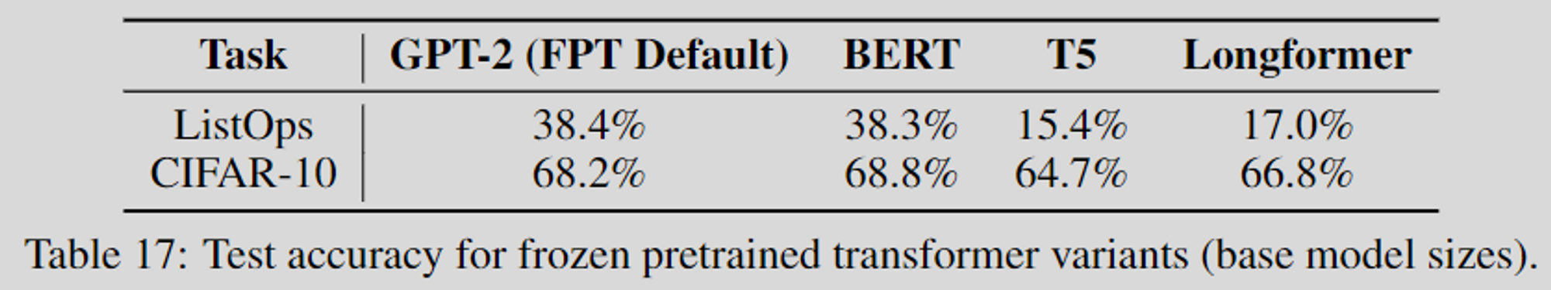
T5 is worse than BERT
enc/dec
enc

Slide 20
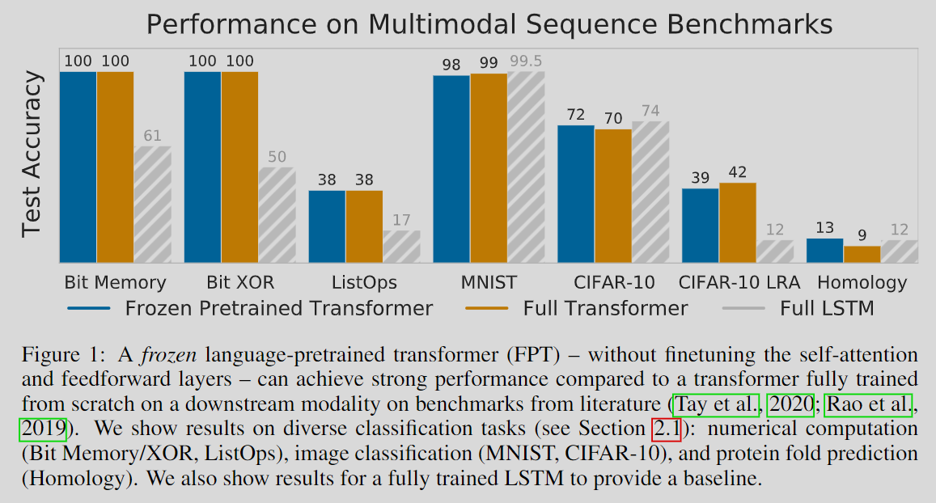
FPT – Results

Slide 21
(GPT4TS) One Fits All: Power General Time Series Analysis by Pretrained LM
Understand how to apply Pretrained LM on time-series

Slide 22
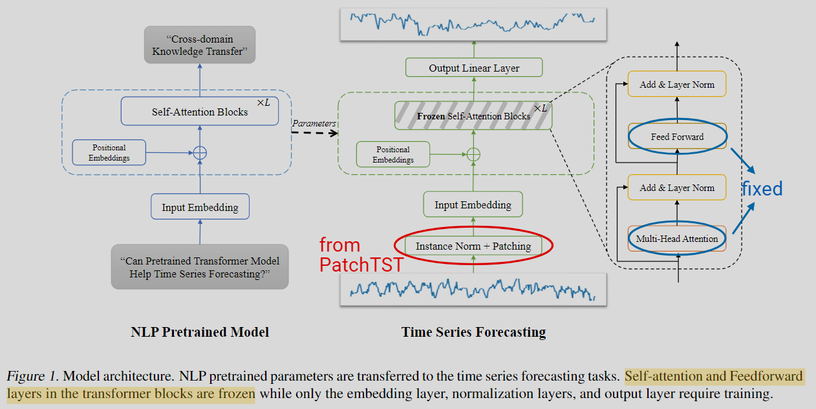
GPT4TS – the same part from FPT
Finetuned Parameters
Input Layer
Positional Embeddings
Layer Norm
Output Layer

Slide 23
GPT4TS – the same part from PatchTST
RevIN
Patching + Channel-independence

Slide 24
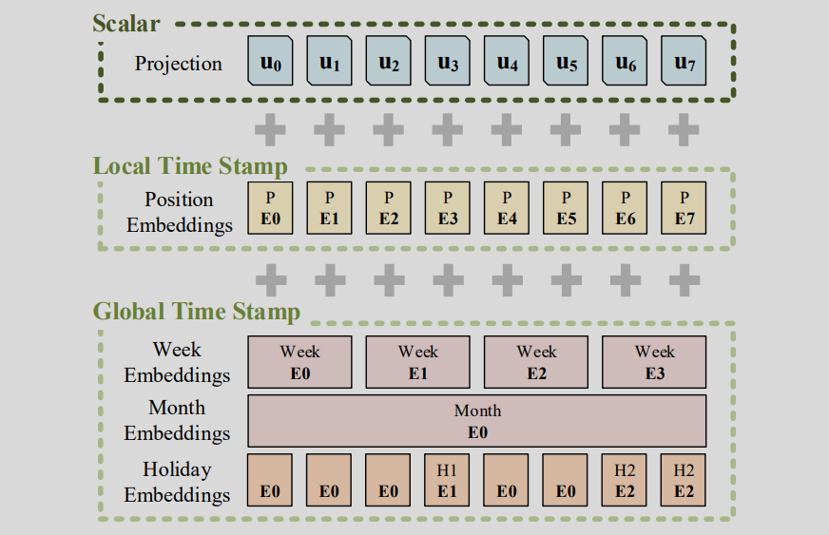
Feeding Multimodal Data into Transformers: Images, Audio, Time-Series, and Tabular Data
(future work)
Input Layer
Output Layer
 | Positional Embedding |  | Input | Output
ViT | Sin/cos, nn.Embedding |  | Patching + Flatten + Linear | Extra learnable [CLS], GAP + Linear
Conformer, Whisper API | Relative sin/cos [Transformer-XL] |  | Conv2d + Linear | Linear + log_softmax
Informer, Autoformer, FEDformer | Positional embedding (sin/cos) | Timestamp embedding (Sin/cos, nn.Embedding) | Conv1dLinear | Linear on C + indexing
PatchTST | Sin/cos (and so many other fixed embeddings) |  | Channel-Independence + Patching+ Linear | Linear on T
GPT4TS | nn.Embedding |  | Channel-Independence + Patching+ Linear | Linear on T

Slide 25
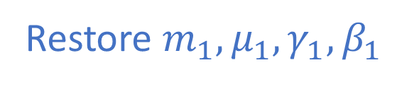

RevIN
(B, …, C)
We still apply z-score normalization on our dataset.
dim2reduce
Remove $m_{1},μ_{1},γ_{1},β_{1}$
Hidden layer
Restore $m_{1},μ_{1},γ_{1},β_{1}$
Input layer
Output layer
…
1
2
3
1’
2’
3’
…
1
2
3
1’
2’
3’
…
1
2
3
1’
2’
3’
…
(B, C, T) → (B, C, T)
RevIN_{remove}
(B, C, T) → (B, C, T)
RevIN_{restore}
We apply normalization on each (instance, channel)

Slide 26




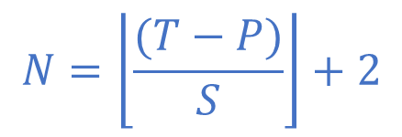


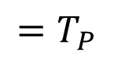


Patching
$$T$$
Univariate
$$N$$
$$=T_{P}$$
$$N$$
…
$$P$$
$$S$$
…
$$P$$
Encoding (token + pos)
$$N=\left\lfloor \frac{(T−P)}{S}\right\rfloor +2$$
It won’t be larger than $S$
…
$$D$$

Slide 27
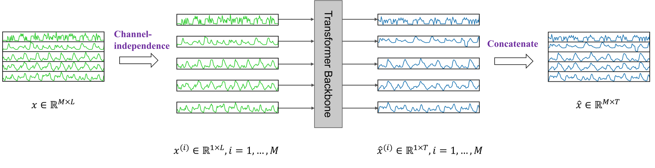
Channel-Independence

Slide 28

Patching w/ multivariate
3.
(B, C, T_{P}, P)
(Channel Independence)
B’
…
$$T$$
…
Univariate
$$N$$
$$=T_{P}$$
2.
$$N$$
…
$$P$$
$$S$$
…
$$P$$
4.
Encoding (token + pos)
$$N=\left\lfloor \frac{(T−P)}{S}\right\rfloor +2$$
1.
It won’t be larger than $S$
…
$$D$$

Slide 29
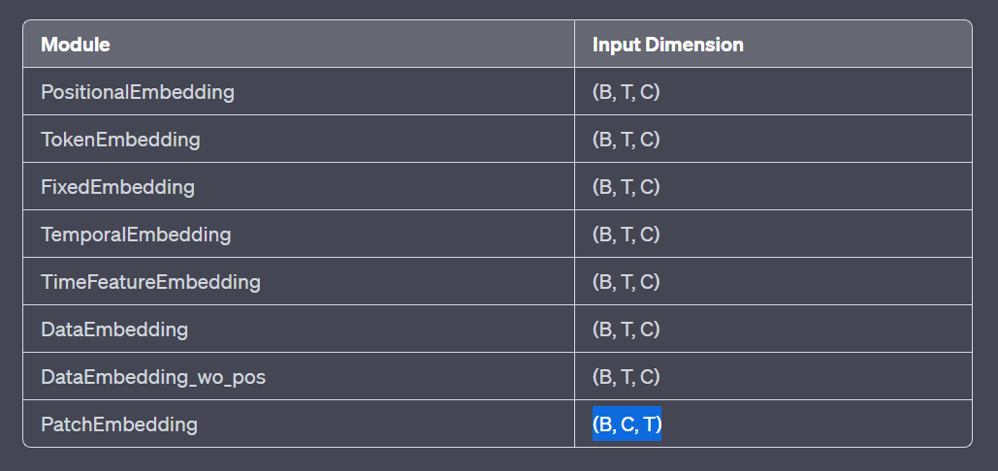
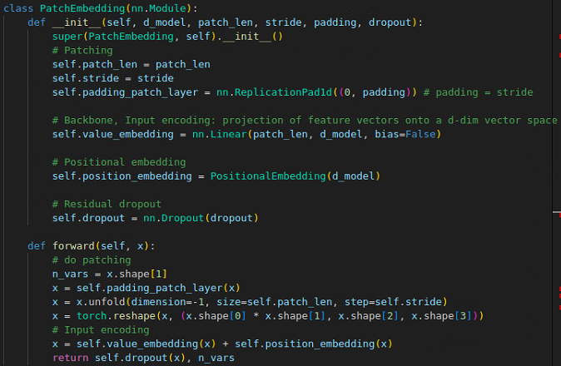
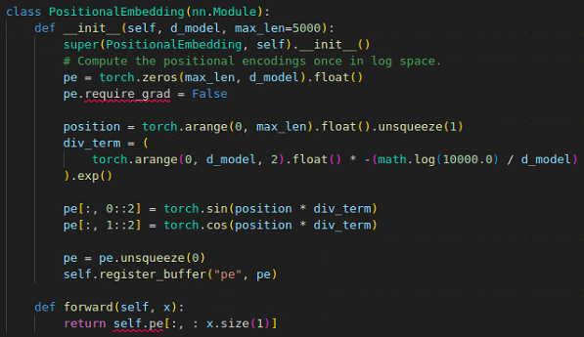
Patching w/ multivariate
x: (B, C, T)
x: (B, T, C)
1.
# (B, C, T) → (B, C, T+S)
2.
# (B, C, T+S) → (B, C, T_{P}, P)
B’
3.
# (B, C, T_{P}, P) → (B x C, T_{P}, P)
4.
# (B’, T_{P}, P) → (B’, T_{P}, D)

Slide 30
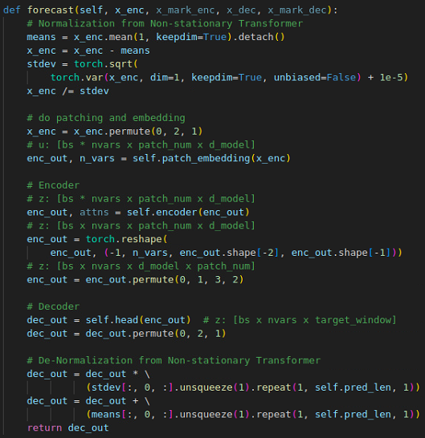
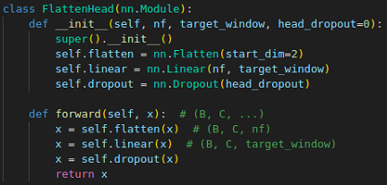
PatchTST from TSlib
(forecasting)
x_enc: (B, T, C)
RevIN’s norm w/o affine
# (B, T, C) → (B, C, T)
# (B, C, T) → (B x C, T_{P}, D)
x: (B, C, T)
# (B x C, T_{P}, D) → (B, C, T_{P}, D)
1.
2.
3.
# (B, C, T_{P}, D) → (B, C, D, T_{P})
4.
RevIN’s denorm w/o affine

Slide 31
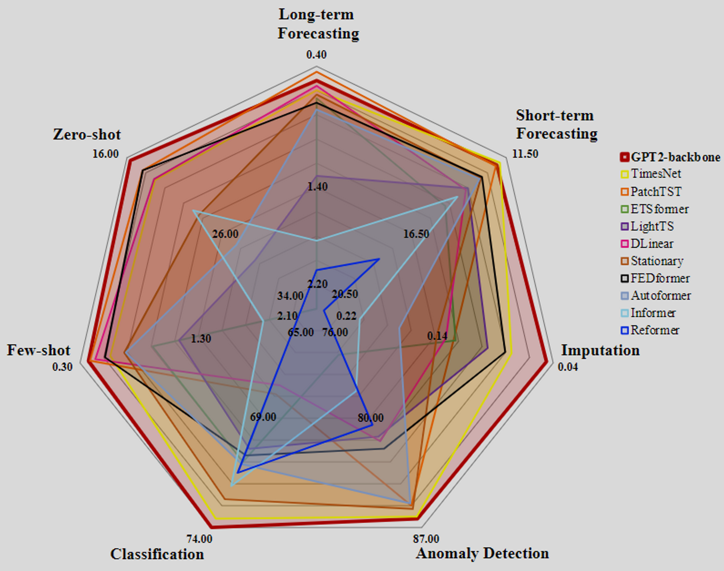
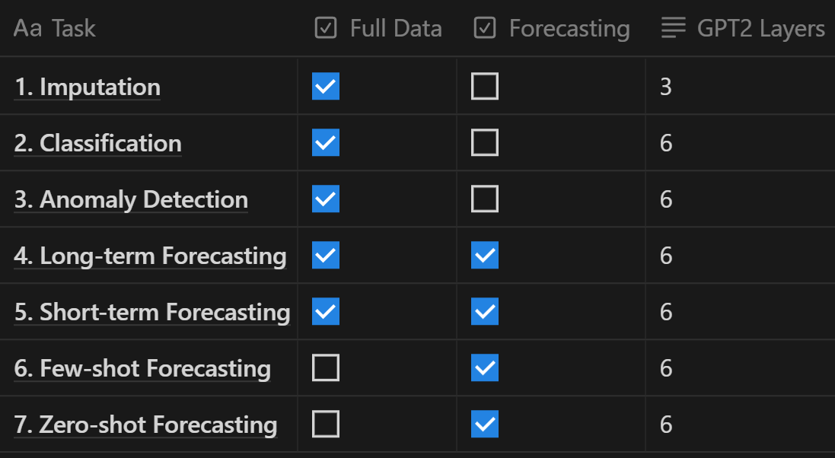
GPT4TS – Results
Main competitor: TimesNet

Slide 32
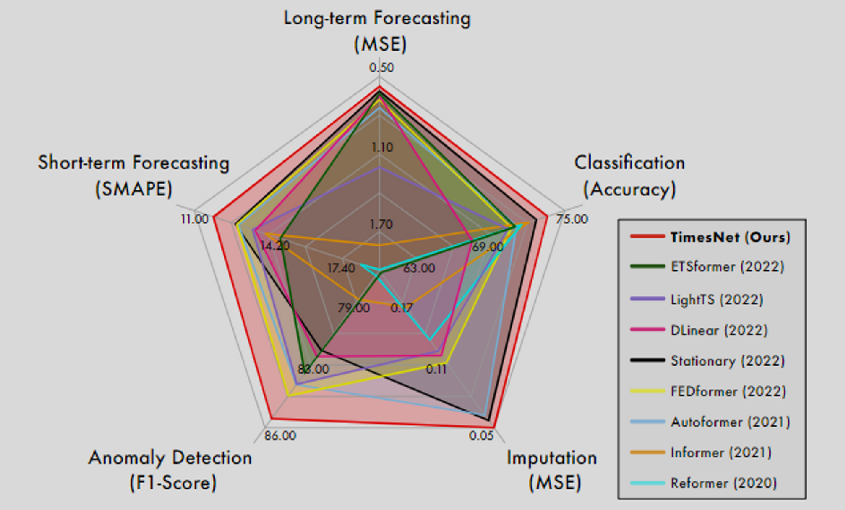
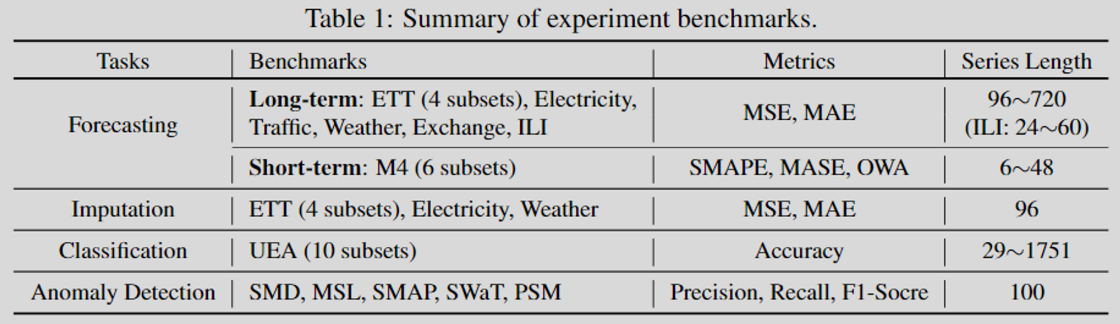
TimesNet

Slide 33
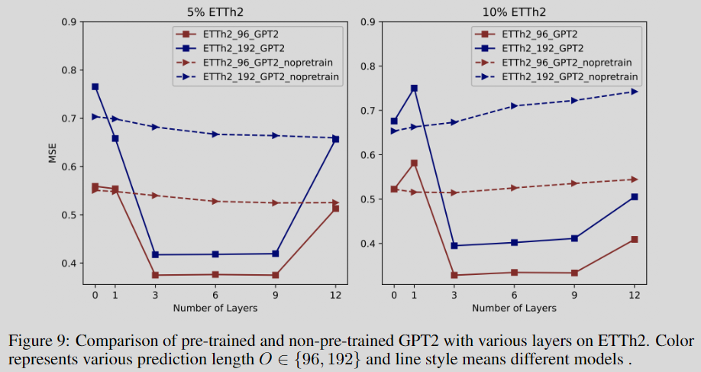
GPT4TS – The Number of GPT2 Layers
GPT2 is still not generalized enough.

Slide 34
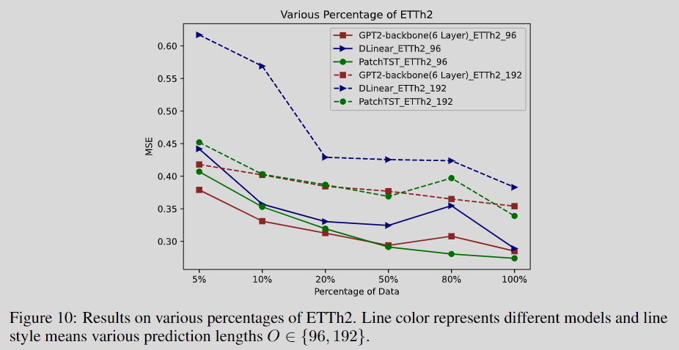
GPT4TS – Analysis of Data Volume
The performance improvement for GPT2(6) FPT is almost flattened.

Slide 35
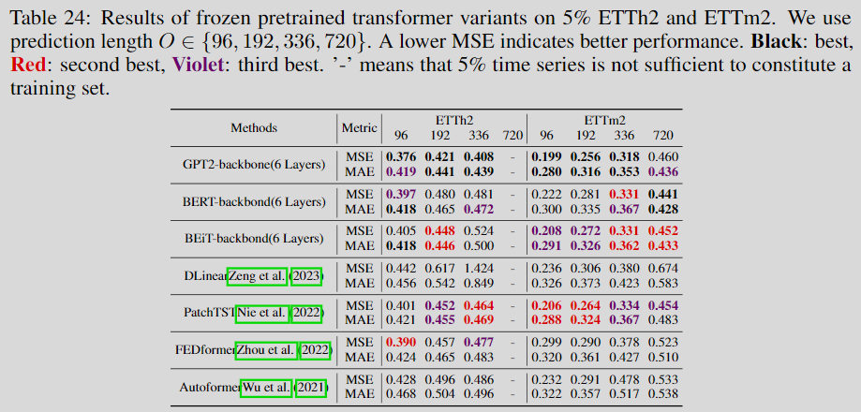
GPT4TS – Other Foundation Models (BERT, BEiT)
FPT is effective across different foundation models.

Slide 36
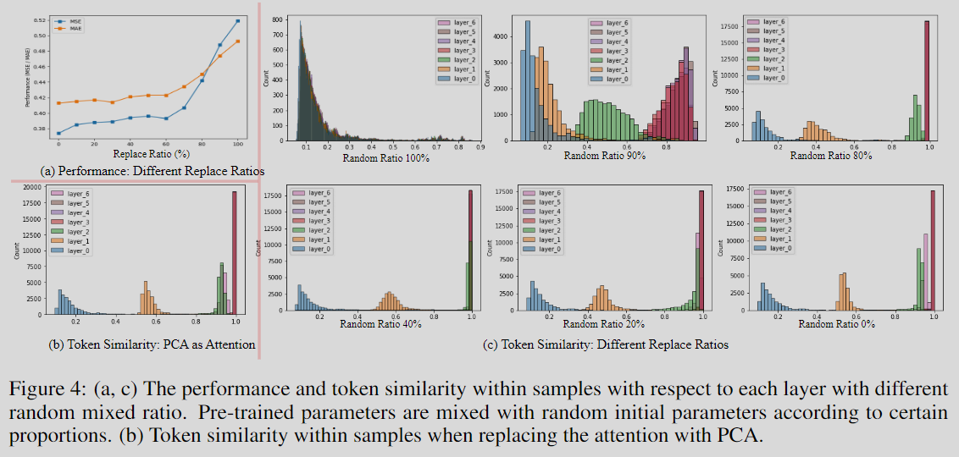
GPT4TS – The Universality of Transformer: Connecting Self-Attention with PCA
The transformer is trained to provide a generic function that is valuable for almost all sequential data analysis.

Slide 37
UniPELT + LLaMA-Adapter V1 V2
Understand how to use different PEFT techniques

Slide 38
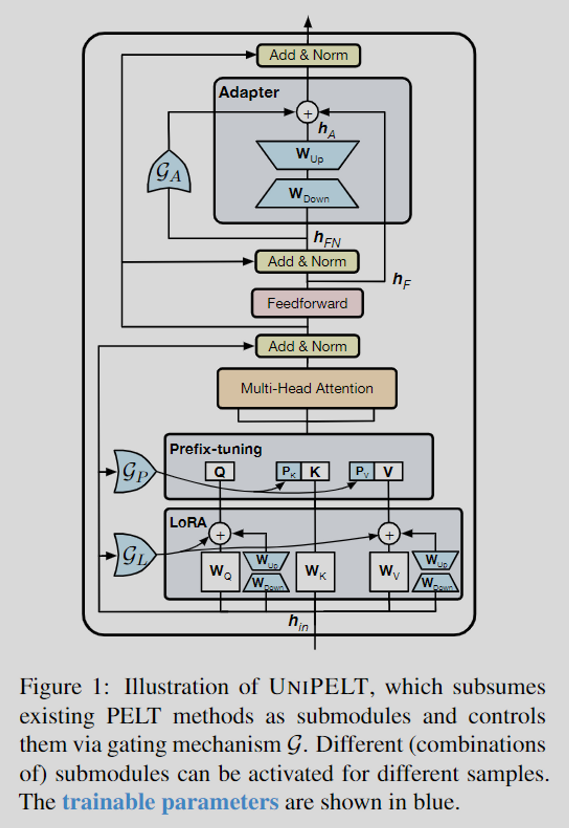
UniPELT – 3 PEFT tricks
Adapter
Prefix-tuning
LoRA

Slide 39

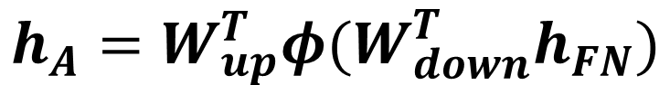
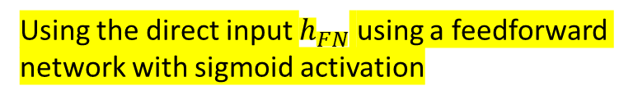
UniPELT – 1. Adapter
$$h_{A}^{′}=𝓖_{A}h_{A}+h_{F}$$
$$h_{A}=W_{up}^{T}φ(W_{down}^{T}h_{FN})$$
bottleneck layer
Gating mechanism for not using the bottleneck layer
Residual connection for using original input
Using the direct input $h_{FN}$ using a feedforward network with sigmoid activation

Slide 40

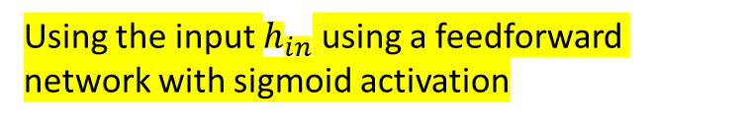
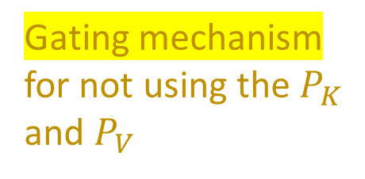
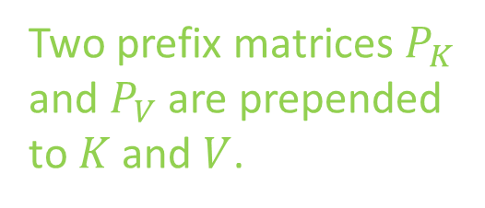
UniPELT – 2. Prefix-tuning
$$Q, K, V$$
Two prefix matrices $P_{K}$ and $P_{V}$ are prepended to $K$ and $V$.
Gating mechanism for not using the $P_{K}$ and $P_{V}$
Using the input $h_{in}$ using a feedforward network with sigmoid activation

Slide 41
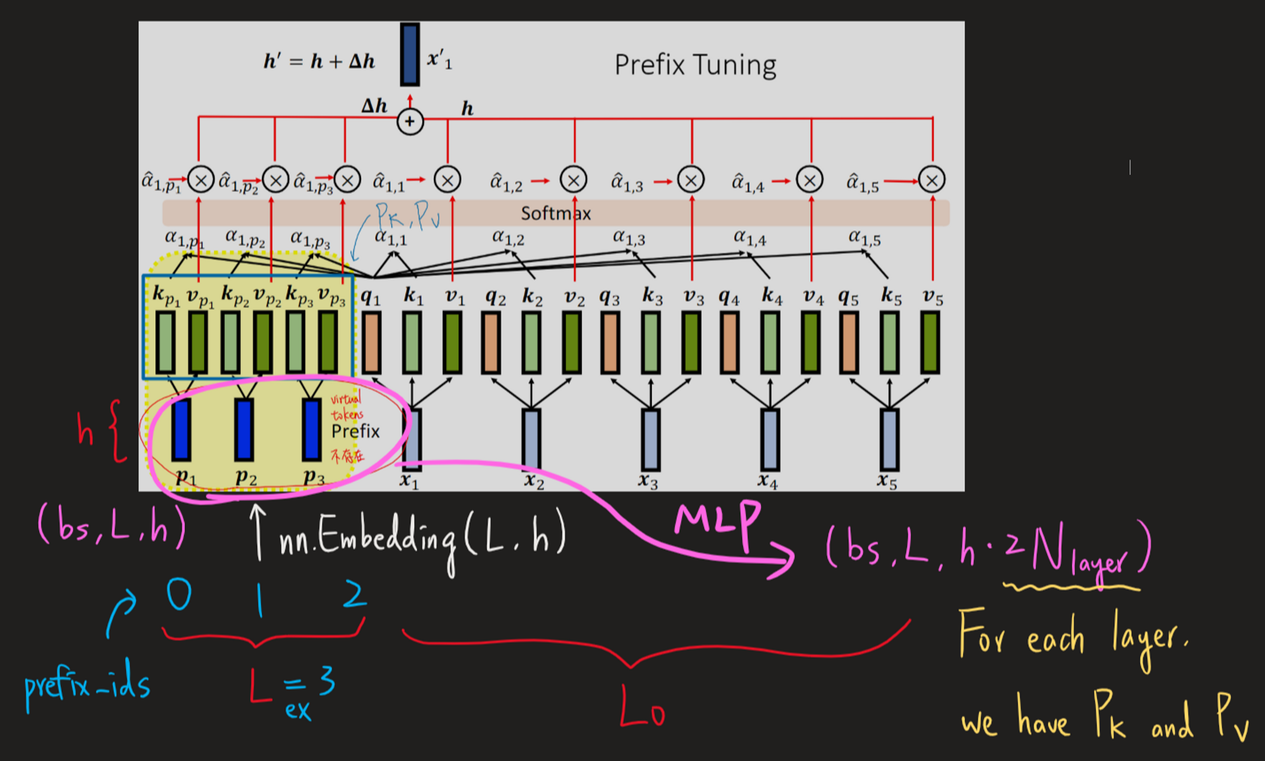
UniPELT – 2. Prefix-tuning
$$Q, K, V$$

Slide 42


UniPELT – 3. LoRA
$$W_{Q}, W_{K}, W_{V}$$
$$Q=\left(W_{Q}^{T}+𝓖_{L}W_{up}^{T}W_{down}^{T}\right)h_{in}$$
bottleneck layer
Gating mechanism for not using the bottleneck layer
Using the input $h_{in}$ using a feedforward network with sigmoid activation

Slide 43
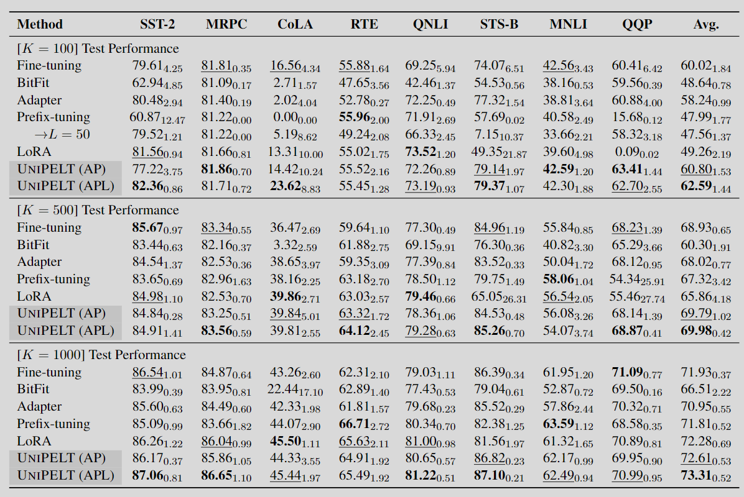
UniPELT – Results

Slide 44
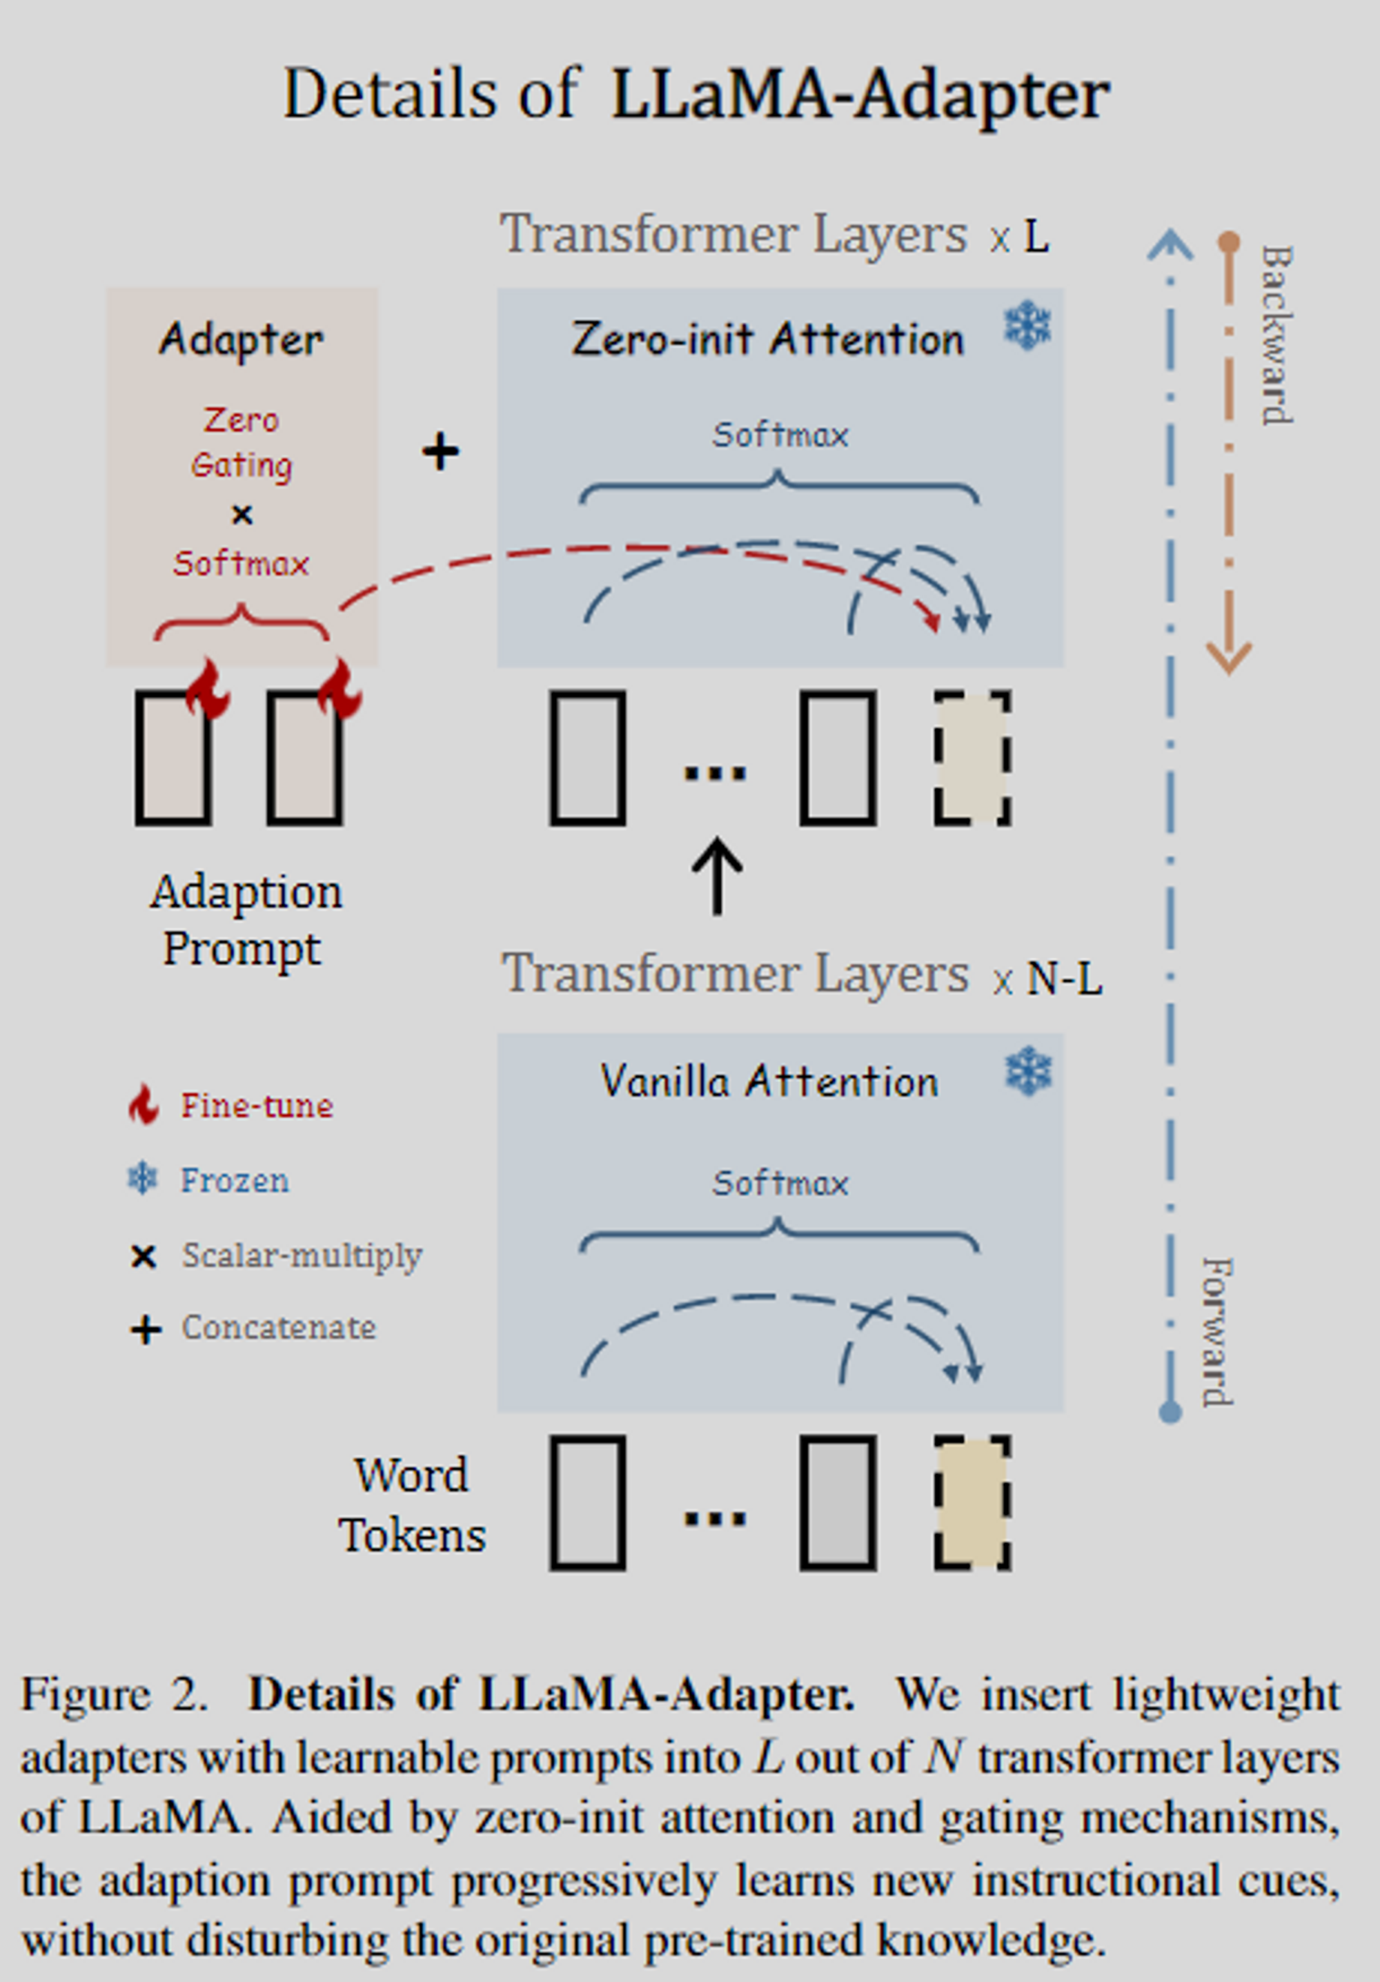

LLaMA-Adapter
In the LLaMA model with 7B parameters, the LLaMA-Adapter fine-tunes 1.2M, or approximately 0.017%, of the network.
V1
Learnable Adaption Prompts
They use real virtual tokens, multiply them by $W_{k}$ and $W_{v}$ for the corresponding $K$ and $V$.
Unlike UniPELT's method of stabilizing training with additional MLP
Zero-init Attention
This mechanism uses learnable, zero-initialized parameters passed through tanh
Unlike UniPELT's neural network gating strategy
V2
Bias Tuning of Linear Layers
They also unfreeze normalization layers.

Slide 45



LLaMA-Adapter – 3. Bias Tuning of Linear Layers
All linear layers in LLaMA
SwiGLU
$$W, V, W_{2}$$
($W_{1},W_{2},W_{3}$)
$$W_{o}$$
$$W_{q},W_{k},W_{v}$$

Slide 46


LLaMA-Adapter – Results

